Slide 1
Welcome
Project'Or RIA is a Project Organizer Rich Internet Application.
Project'Or RIA focuses on IT Projects, but is also compatible with all kinds of Projects.
Its purpose is to propose a unique tool to gather all the information about the projects.
The fact is that many Project Management softwares just focus on planning. But it is a much too restricted point of view. Of course planning is an important activity of Project Management and is one of the keys to Project success, but it is not the only one.
Project Managers need to foresee all what can happen, measure risks, build action plan and mitigation plan.
It is also important to track and keep traces of all what is happening to the Project : incidents, bugs , change requests, support requests, ...
In this objective, Project'Or RIA gives visibility at all levels of Project Management.
At lower level, the Project follow-up consists in gathering all information, and maintain it up to date. This involves all the operational team.
At upper level, Project Steering uses the follow-up data to take the decisions and build the action plan. This allows to bring the adjustments needed to target on the objectives of the project.
The goal of Project'Or RIA is to be Project Management Method independent. Whatever your choice on the method, you can use Project'Or RIA.

Slide 2
Functional (1/3)
Work
Tickets follow-up, for short activity follow-up such as support or bug fixing.
Activities follow-up, for work needing to be planned such as development or evolution.
Milestones follow-up, to define key dates of the planning.
Hierarchic level management via links of Activities, Tickets or Milestones to parent Activity.
Dependencies management between Activities, Milestones and Projects for accurate planning.
Assignment of resources to activities.
Workload management.
Workflow definition for status change.
Follow-up
Planning functionality, in a simple and understandable way, taking into account resource capacity, resource affectation rate to project and resource assignment rate to activity.
Planning presentation for projects, activities, milestones and dependencies in a Gantt view.
Workload follow-up for resources.
Printable reports.

Slide 3
Functional (2/3)
Risk Management Plan
Risk follow-up, with complete description of risks and criticality enlightening.
Action follow-up, with complete description, status and accountable assignment.
Issue follow-up, to track Project issues when risks occur.
Links management, between Actions, Issues and Risks.
Review logs
Meetings follow-up, with summary of status and minutes.
Decisions follow-up, with full description and origin reminder.
Questions management, to track exchanges and responses.
Links management, between Meetings and Decisions and Questions.
Tools
Message management, to communicate to users through Today screen.
Import elements (tickets or else) from CSV files.
Environment
Clients and Projects definition.
Resources definition, for people working on Project, gathered in Teams.
Users definition, for people connecting to the tool.
Access Right Management, based on profiles completely customizable.

Slide 4
Functional (3/3)
Parameters and lists of values
Every parameter, every list of values may be changed through a devoted screen.
Security
Login management for restricted access.
Full profiles definition and rights management for reading, creating, updating and deleting.
Others
Advanced filter functionality.
Automatic email generation on status change.
Traceability of each update on items, displayed on change history section of each item.

Slide 5
Technical (1/3)
Easy to use
Project'Or RIA proposes a user friendly interface.
Rich Internet Application running as a light client, in a simple browser.
Multi-browser compatible (validated on Internet Explorer 8, FireFox 3 and Chrome 5).
Using AJAX, page refresh is always limited to the target area, avoiding blank pages and flickering.
General user interface is designed to conform to many usually used tools (such as webmail) :
- menu on left hand,
- data on right hand, divided on top as list of items and at bottom as detail for selected item.
Selecting an item in the list directly displays its detail.
Possibility to access to history of changes is offered on every item.
Notes management enables to attach comments to any item.
File attachment is proposed for most important items.

Slide 6
Technical (2/3)
Easy to install
Project'Or RIA uses very well known technologies : PHP / MySQL / AJAX.
Set up only requires the usual trilogy : Apache, MySQL, PHP.
Just use your favorite package : XAMPP, LAMP, WAMP, EasyPHP, ZEND Server ...
Required versions:
- Apache : any version, V2 or above is recommended,
- MySQL : any version, V5 or above is recommended,
- PHP : 5.2 or above needed.
For information, Project'Or RIA has first been developed with Easy PHP 2.0.0.0
[Apache V2.2.11, MySQL 5.1.30, PHP V5.2.8]
and is now developed under ZEND Server 4.0.5 Community Edition
[Apache V2.2.12, MySQL 5.1.35, PHP V5.2.10]
Automatic version management triggers Database structure updates at first run for any new version.
Set-up screen at first run to define internal parameters (database access, default parameters,...).

Slide 7
Technical (3/3)
Easy to parameter
Every user parameter, every list of values may be changed through a devoted screen.
Default parameters are proposed, corresponding to most common needs.
Language selection, proposed on locale value, editable by user (only English and French for current version).
Easy to customize
As Project'Or RIA is proposed under open source GPL Licensing, you may adapt it to your needs.
Project'Or RIA has been developed as a Framework, so it is very easy to add an element or add a data or change display for an element.

Slide 8
Installation
Pre-requisites :
- http server
- PHP server (5.2 or over)
- MySQL database (5 or over)
For instance, you may try to set-up an EasyPHP server, including all required elements.
This set-up is not recommended for production purpose, but only for testing and evaluation purpose.
You may also set-up a Zend Server, including all required elements.
This set-up can be used for production purpose.
Set-up :
- Unzip projectorriaVx.y.z.zip to the web server directory
- Run application in your favorite browser, using http://yourserver/projectorria
- Enjoy !
Notice :
- At first run, configuration screen will be displayed.
- To run again configuration screen, just delete "/tool/parametersLocation.php" file.
- On first connection, database will be automatically updated, it may take several minutes.
Support :
- you may request support in the Forum of Project'Or RIA web site :
http://projectorria.toolware.fr

Slide 9

Configuration
When you first log, normal process should be :
  configuration screen is displayed
  you fulfill data corresponding to your environment
  you then click on "OK" button
  a spinner is displayed
  the spinner disappears : at that moment, you should see a message and a new "Continue" button below the "OK" button
  you click on the "Continue" button
  screen changes to Logon screen
  you enter default login : admin/admin and click "OK" button
  spinner is displayed : this step may take a certain time (about 1 minute) because all the database structure is created
  spinner disappears and a short message indicates result of database creation (detail of this step is written in log file)
  click again on "OK" and you're in !
If all of this do not work, try this solution :
  get “/tool/parameters.php” file
  manually update this file with your own parameters
  create a new file : “/tool/parametersLocation.php” containing:
    <?php $parametersLocation = "parameters.php";
You can move /tool/parametrers.php, then you just have to indicate its full way in “/tool/parametersLocation.php”.
  Make sure to store your parameters.php file out of web access to avoid having your security information stolen (for instance connection login to your database)

Slide 10
Parameters (1/4)
Fields filled in Configuration screen are stored in parameters.php file. Here is the mapping.
Caption | Description | Variable name
Database type | The database type. Leave 'mysql' (only possible value). | $paramDbType
Database host | MySql Server name (default is 'localhost'). | $paramDbHost
Database user to connect | MySql valid user (default is 'root'). | $paramDbUser
Database password for user | MySql password for user (default is 'mysql', should be changed). | $paramDbPassword
Database schema name | MySql database instance name (default is 'projectorria'). Database will be automatically created if it does not exist. | $paramDbName
Name to be displayed | A name that will be displayed on the bottom of the main screen. Any value is possible to identify connected database. | $paramDbDisplayName
Database prefix for table names | Prefix on table names. It is used to store several instances under same schema. It may be left blank. | $paramDbPrefix

Slide 11
Parameters (2/4)
Caption | Description | Variable name
eMail address of sender | The email address used as sender for mailing function. Must be a valid email address. | $paramMailSender
eMail address to reply to | The email address used to define the ‘reply to’ for mailing function. Must be a valid email address. | $paramMailReplyTo
eMail of administrator | The email address of the administrator. It will appear on error messages. Should be a valid email address. | $paramAdminMail
SMTP Server | Address of SMTP (mail) server. May be left blank (default is 'localhost'). | $paramMailSmtpServer [New in V1.2.0]
SMTP Port | Port to talk to SMTP (mail) server (default is '25') | $paramMailSmtpPort [New in V1.2.0]
Sendmail program path | Path to program used to send mails. To set only on issue to send mails, or if not using default sendmail program. | $paramMailSendmailPath [New in V1.2.0]
Automatic mail title | Title of automatic mails. May content ${item}, ${id}, ${status}, ${name} (*). Default value is proposed on configuration screen. | $paramMailTitle [New in V1.2.0]
Automatic mail message | Main body message of automatic mails. May content ${item}, ${id}, ${status}, ${name} (*). Default value is proposed on configuration screen. | $paramMailMessage [New in V1.2.0]
Automatic mail show detail | Tag to specify whether the detail of the element should be included in the message body. Possible values are 'true' or 'false' (default is 'true'). | $paramMailShowDetail [New in V1.2.0]
(*) ${id} : the id of the element
${item} : the class of the element
${status} : the new status of the element
${name} : the name of the element

Slide 12
Parameters (3/4)
Caption | Description | Variable name
Default password for initialization | Default value used to reset users password. Any string is possible as default password (default is 'projector'). | $paramDefaultPassword
Min length for password | Minimum length of accepted new password. Any integer is possible, to force a long password (default is '5'). Keep is reasonable ! | $paramPasswordMinLength
Disable password change functionality | Tag to disable password change functionality for users (if set to 'true'). Then, only the administrator can reset passwords. Possible values are 'true' or 'false' (default is 'false'). | $lockPassword
Default locale to be used on i18n | Default language used by Internationalization functionality. Will be overridden by user’s choice on user parameters screen. Possible values are 'en' for English or 'fr' for French (default is 'en'). More locales should come with next versions. | $paramDefaultLocale
Default time zone | Default time zone (default is 'Europe/Paris'). List of possible values can be found at : http://us3.php.net/manual/en/timezones.php. | $paramDefaultTimezone
Use fading mode for frames refresh | Tag to indicate that screens will appear in a fading motion, to avoid flickering screens. Possible values are 'true' or 'false' (default is 'true'). | $paramFadeLoadingMode
Number of row per page on main Grid view | Number of rows that will be rendered at a time. Any integer value is possible (default is '50'). See Dojo for more details on this topic. | $paramRowPerPage
Icon size on menu tree | Size of icons displayed on menu bar (left side). Possible values are '16' for small icons, '22' for medium icons, '32' for big icons (default is '22‘). | $paramIconSize
Default color theme, proposed while login | Default color theme, proposed while login. Possible values are 'blue', 'red', 'green', 'orange', 'grey', 'white' or 'random' for randomly selected (default is 'blue‘). | $defaultTheme [New in V1.3.0]

Slide 13
Parameters (4/4)
Caption | Description | Variable name
Path separator | The path separator depending on the operating system. Possible values are '\' for Windows, '/' for Unix“. Remark : '/‘ will also work on most Windows, so it is default value. | $paramPathSeparator
Directory to store Attachments | Directory where attached files will be stored. Can be any valid directory. PHP server must have write rights to this directory. If set to empty string, attachment facility will be disabled. Default value is '../files/attach/' : as it is within web structure, it should be changed for security reasons. | $paramAttachementDirectory
Max file size for attachment | Max file size for attached files. Size is in bytes (1024 * 1024 * MB). Default value is '2097152' = 1024 * 1024 * 2 = 2 MB. | $paramAttachementMaxSize
Temp directory for reports | Directory to store temporary images for reports . It may be any valid directory into the web structure (must be web-reachable). Default is '../files/report/' and may be kept as is. | $paramReportTempDirectory [New in V1.4.0]
Log file name | Name of log files, including path. Can be any valid file name. PHP server must have write rights to this file (or at least to the directory). May contain '${date}' to get 1 file a day. Default value is '../files/logs/projector_${date}.log‘: as it is within web structure, it should be changed for security reasons. | $logFile
Log level | Logging level, used for debugging purpose. Possible values are '4' for script tracing, '3' for debug, '2' for general trace, '1' for error trace, '0' for none (default value is '2‘). | $logLevel
Setup Dojo debugging mode | Tag to enable Dojo debugging facility. Possible values are 'true' or 'false' (default is 'false'). | $paramDebugMode
Parameter file name | Name of the file where all previous parameters will be stored. Default value is '../files/config/parameters.php' : as it is within web structure, it must be changed for security reasons. | Stored as $parametersLocation in parametersLocation.php file

Slide 14

Installing new version
Project’Or RIA will constantly evolve to fit users needs.
To deploy a new version just unzip the new projectorriaVx.y.z.zip to the web server directory and connect to the application.
Database updates will automatically be triggered.
When done, a message will display the synthesis of the updates (number of errors if any).
You will find details of the updates in the log file.
Some new versions may also add new parameters.
These will of course be integrated in configuration screen.
If you deploy one of these versions from a previously installed one, new parameters will automatically be inserted at the end of your “parameter.php” file, with a default value.
You will then be able to update this value to your context, by modifying the file.
In these cases, a message will inform you that new parameters have been added, on login screen, just before the “Updated Database” message.
  Pay attention that if you are upgrading from version lower than 1.1.0, you must remove last script closure (?>) in “parameters.php” file before upgrading.
  It is highly recommended to back-up your Database before upgrading to new version, to be able to get back to previous version.
  You can upgrade twice (if needed) : update “parameter” table, reset the value of line where parameterCode='dbVersion' to the previous version number and connect again.
  If you then notice that some menu items have disappeared, just check for double entries in “habilitation” table (last lines) and delete them.

Slide 15
Connection
Login to the application uses a standard login screen : users must enter “user name” and “password”.
Just notice that on this screen users have the possibility to change their password, and it is the only place where they can do this.
This functionality can be disabled (see parameters).
The administrator is then the only one able to reset the passwords to the default value (see parameters).
When a password has been reset to default value, the user must change it on first connection.
For the first connection to a newly installed version of Project’Or RIA, just use the default account : “admin” / “admin”
You must then go to “user ” screen to create new users.
  Don’t forget to change the default password for “admin” user, or delete the “admin” user.
  Remember to always have a user with “ admin ” rights to be able to create new users and change profiles.

Slide 16
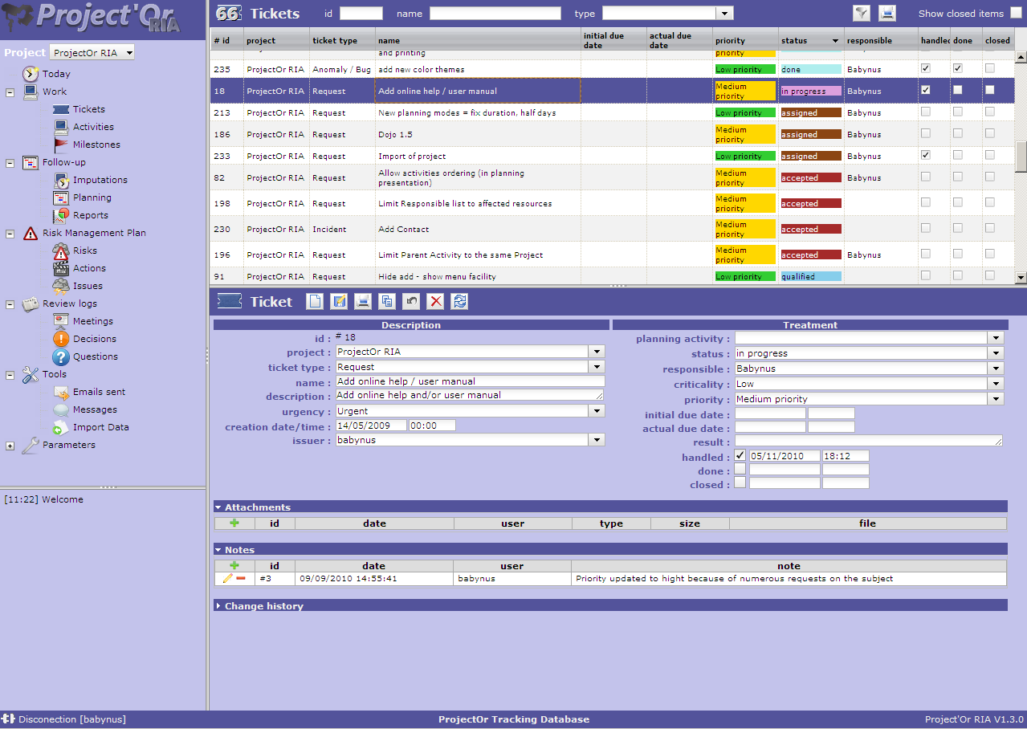
Graphical User Interface (1/6)
Generality
Graphical User Interface is set into several areas.
Some splitters are provided to enable resizing of the parts.
Logo area
Splitter
List area
Menu
area
Splitter
Detail
area
Splitter
Message area
Info bar

Slide 17
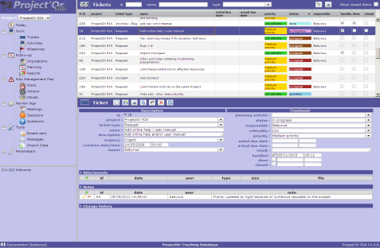

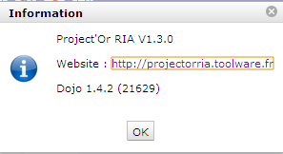

Graphical User Interface (2/6)
Toolbars and else
Clicking on the Logo Area will display the “About” pop-up.
Click on the Help icon will open the online user manual, to the page corresponding to the actual screen, if existing in the manual.
Click on left side of Info bar disconnects user.
Database Name is displayed in the middle of Info bar.
Version of Project’Or RIA is displayed on the right of Info bar. Click here to go web site.
Two buttons provide Show/Hide functionality for menu (left part) and switched mode for list and detail, so that selected element is displayed in “full screen” mode.
When hidden, these areas are replaces by small grey bars. Moving the mouse over the bar displays the initial area.
Message area displays information about main actions : insert, update, delete.
Timestamp indicates when action was done.
This is only a temporary logging area.
Messages displayed here are not stored and will not live more than user connection.

Slide 18
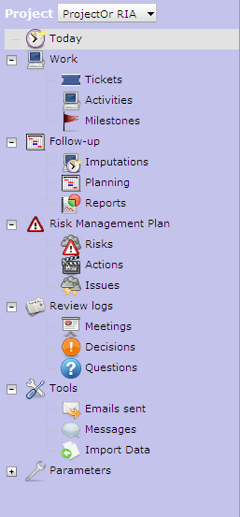
Graphical User Interface (3/6)
Menu
Menu area is proposed as a tree view of reachable items.
The presented items will depend on user habilitation to the screens.
The Project combo box allows to restrict the visibility of all objects to the dedicated project, including sub-projects if any.
Click on a grouping line will expand-shrink the group.
Click on a item will display the corresponding screen in the main area (right side of the screen).

Slide 19
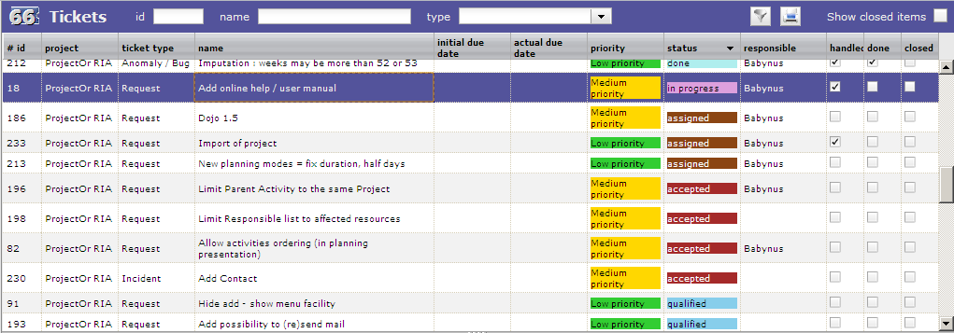
Graphical User Interface (4/6)
List
The main area (right side of the screen) is generally divided in two parts : List area and Detail area.
The upper part lists all the object (for instance, here are tickets).
On top left part, the number of listed items is displayed (here = 66).
Rapid filtering fields are proposed : “id”, “name” and “type” (if significant for the object).
Any change on “id” and “name” will instantly filter data. Search is considered as “contains”, so typing “1” in “id” will select “1”, “10”, “11”, “21”, “31” and so on.
Selecting a “type” in the combo box will restrict the list to the corresponding type (will request server).
Check the “show closed items” to list also closed items.
For more complex filtering, click on the “filter button” (see next page for details).
Click on the “print button” to get a printable version of the list.
Click on the header of a column will sort the list on that column (first ascending, then descending).
The sorting is not always on the displayed name : if the sorted column is linked to a reference list with sort order value, the sorting is executed on this sort value (for instance, here the sorting on the status is executed corresponding to Status sort order value, defined as a logic workflow for status change).
Click on a line (any column) will display the corresponding item in the detail area.

Slide 20
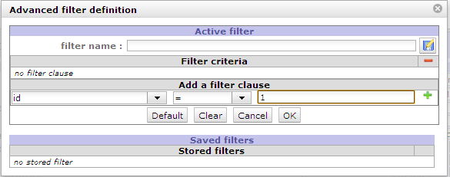
Graphical User Interface (5/6)
Filters
For complex filtering, click on the “filter button” .
The filter pop-up presents two areas : “Active filter” and “Saved filter”.
Enter new clause in Active filter : in “Add a filter clause”, select the name of the field, the operator and the value for the clause. Then click on to add the clause to the filter criteria.
Click on on a clause line to remove it.
Click on on the header of Filter criteria to remove all clauses. This can also be done by clicking the “Clear” button.
When Filter criteria is correct, click on “OK” button to apply the filter to the list.
You can also click “Cancel” button to revert to previous filter.
At any step you can enter a filter name and click on to save the filter definition.
Click on a Saved filter to retrieve its definition (filter criteria).
Click on on a saved filter to delete it.
Click on “Default” button to set actual stored filter as default, kept even after disconnection.
When filter is applied, filter button in the list area is checked .
  When filter is a list of values (with “amongst” operator), multi-value selection is possible using [CTRL] key.
  Filters are defined and stored for a user and a type of item (a screen).
  When a filter is applied to a type of item, coming back after moving to another type (another selection in the menu) will apply the previously defined filter.
  After disconnection, currently applied filter is lost, but stored filters are saved. Default filter (if selected) is also stored and will be automatically applied on next connection.

Slide 21
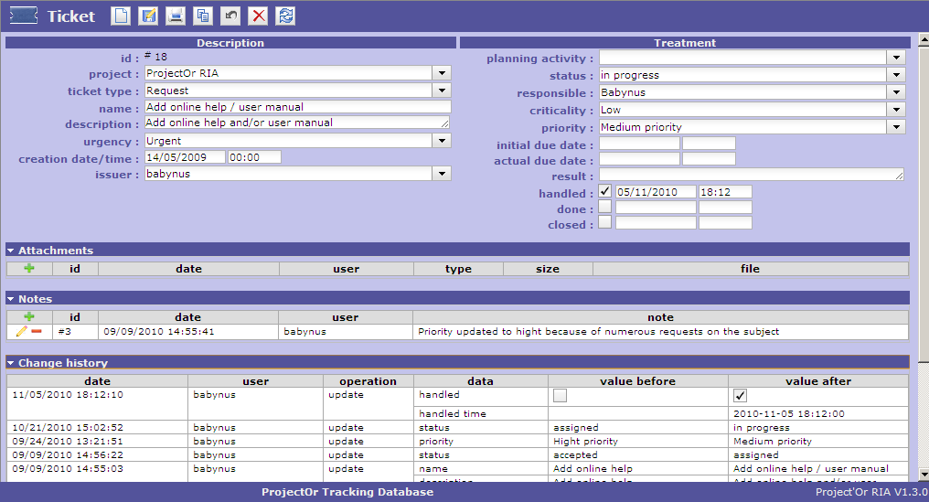
Graphical User Interface (6/6)
Detail
The Detail area present the detail of the selected in the list.
Click on to create new item, to save the changes, to get a printable version of the detail,
to copy the current item, to cancel ongoing changes, to delete the item and to refresh the display.
Some buttons are not clickable when change are ongoing : , , , , .
button is clickable only when changes are ongoing.
On dependant items (for instance “Notes”), click on (in header) to add new, to edit and to delete.
  When changes are ongoing, you can not select another item or another menu item.
  Save or cancel ongoing changes first.

Slide 22
Themes (1/2)
Users can select colors Theme to display the interface.
Just go to Menu "Parameters" ⇨ "Users parameters", and select the new theme in the "theme" select list.
New theme is automatically applied when selected.
Just save parameters to retrieve this theme on each new connection.
Administrator defines on parameters file a default Themes that will be applied on Login screen and up until the users selects a specific theme.
The “random” Theme is not really a Theme, it is a functionality to randomly select a Theme on each new connection.

Slide 23
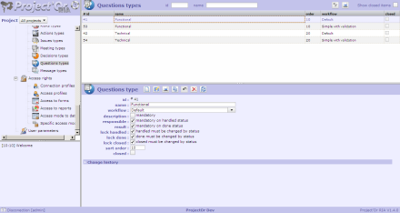
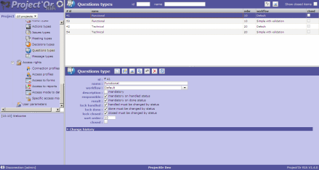
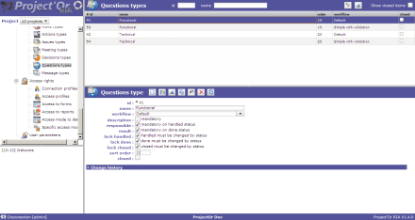
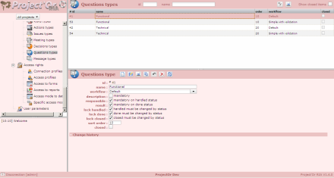
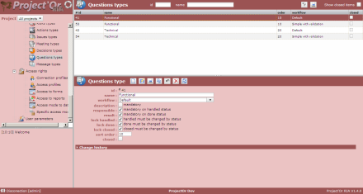
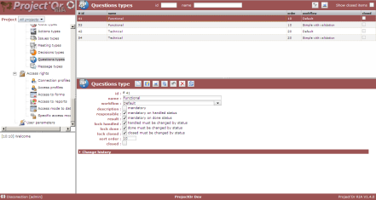
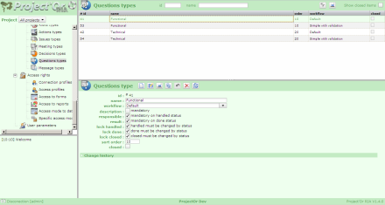
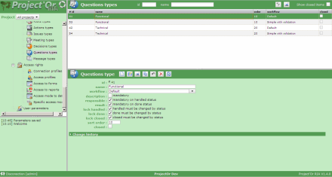
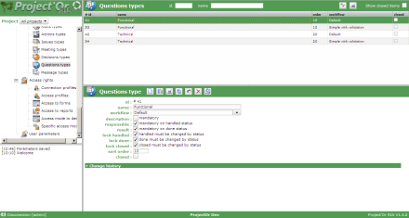
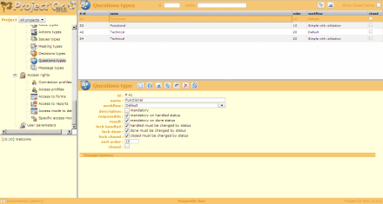
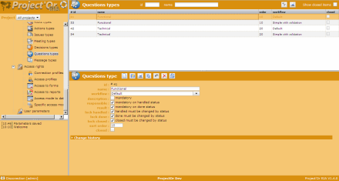
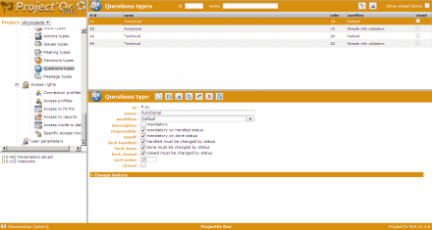
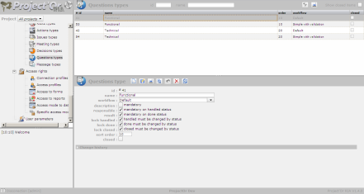
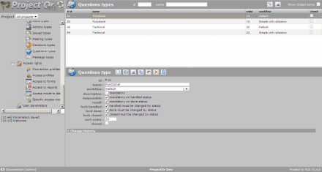
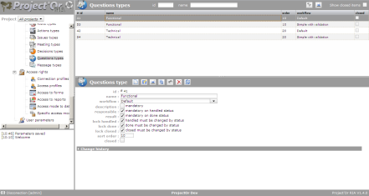
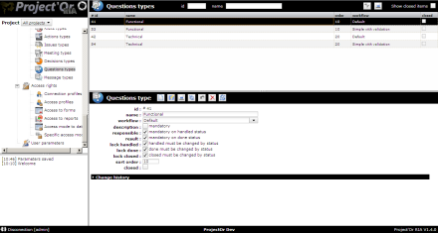
Themes (2/2)
Light
Dark
Contrasted
Blue
Red
Green
Orange
Black & White
Grey

Slide 24
Multilingual
Project’Or RIA is multilingual.
Each user can choose the language to display all the captions.
Of course, data is displayed as input, no translation is operated.
On the login screen, the locale of the browser is user to display captions.
When connected, the language selected (and saved) by the user is used.
When selecting new language, only refreshed data will use new selected language. For instance, all menu items will be kept in the old language. To actualize, save parameters, disconnect and reconnect.
Administrator can define the default language. This one is used on login screen only if browser locale is not recognized as a known language.
  All the captions and messages are stored in an Excel file : /tool/i18n/nls/lang.xls.
  To change (or correct) any data, on a windows set-up, open the file to its default place,
  enabling macros.
  “Save-as”, with the same name (to insure the default repository is the default one).
  Click on generate button.
  All the corresponding language files are automatically generated, in /tool.i18n/nsl subfolders.
  To translate to a new language, update one of the existing columns, test using the corresponding locale, and when completed submit the file to support@toolware.fr, to have the new language integrated in the tool.

Slide 25
Creation specificity
  It may sometimes seem that you are not able to attach a file to your new ticket.
  In fact, since a user can update a ticket, he is able to insert an attached file.
  So this is not a question of habilitation.
  The reason is that this functionality do not appear during creation.
  You just have to save first to be able to attach a file.
  This rule is valid for all depending items : Attachments, Notes, Assignments, Predecessor elements, Successor elements and links between Risk, Actions and Issues.
  Just one word : "save" first.
Since V1.3.0, you can rapidly save with [CTRL]+S, like in many office tools.

Slide 26
Update specificity
Since V1.3.0, you can rapidly save with [CTRL]+S, like in many office tools.
When updating an item, only updated fields are stored in the database. This means that if two users are updating different fields of the same item, they don’t crush values updates by each other.

Slide 27
Delete specificity
  After deleting an item, you will not be able to see it any more.
  Data is physically deleted from the database.
  Only the update history can then be access through dedicated reports.
Always consider setting an item to “close” status rather than deleting it. You will then not see it on main screens, but will be able to fetch it, using the “show closed item” checkbox in lists, and possibly re-activate it.
Deleting functionality should be reserve to remove invalid newly created items.
Items with existing dependencies can not be deleted.
Examples :
  You can not delete an activity is resource is assigned to it.
  You can not delete an assignment is real work has been entered (imputation).
  You can not delete a project with existing items.
  …

Slide 28
Ticket
To be completed

Slide 29
Activity
To be completed

Slide 30
Milestone
To be completed

Slide 31
Real work allocation
To be completed

Slide 32
Planning (1/3)
Planning is calculated “as simply as possible”.
This means that no complex algorithm, with high level mathematic formula, is involved.
The principle is simply to reproduce what you could do on your own, with a simple Excel sheet, but automatically.
Planning is Cross-Project, through affectation rate on the projects.
All the left work is planned, from starting date, to the max date to be able to plan the work.
Calculation is executed task by task, ordering thanks to :
- dependencies (if an activity has a predecessor, the predecessor is calculated first),
- planning mode : regular between dates are planned first
- priority : the smaller values are calculated first
- left work : activities with more less work are planned first
Planning will distribute left work on future days, taking into account several constraints :
A resource has a capacity
Most of the time Capacity = 1 (1 person), but it may be more (if the resource is not a person but a team) or less (if the person work only partial time).
A resource is affected to a project, at a certain rate
If resources are not shared between projects, so rate will probably always be 100%.
But if resources are shared, then rate could be less than 100%. If a resource is equally shared between two projects, then each project should enter a rate of 50%. This will lead to control that planning for each project will not overtake rate capacity, so that first project planning its activity will not take all the availability of the resource.
Project affectation capacity is controlled on a weekly basis. This means that planning for a project (including sub-projects) will not be more than (Resource Capacity) x (Resource affectation rate) x 5 for a given week.

Slide 33
Planning (2/3)
A resource is assigned to an activity, at a certain rate
By default, assignment rate is 100%. But it may be less. This means that planning will keep some availability for other tasks.
Assignment capacity is controlled on a daily basis. This means that planning for an activity will not be more than (Resource Capacity) x (Resource assignment rate) for a given day.
An activity has dependencies
An activity will always be planned after its predecessors (and this is recursive).
An activity has a priority and planning mode
Activity with lower priority will be planned first (after taking account of dependencies).
Default priority is 500 (medium).
Possible Planning modes are :
  As soon as possible: Default planning behavior. Task is planned to finish as soon as possible
  As late as possible: Task is planned from end to start.
  Validated end date must be set-up
  Regular between dates: Planning will be equally dispatched from start to end. This mode is best fitted for management activity of recurrent activities not easy to precisely plan.
  Validated start date and Validated end date me be set-up
  Regular in full days: Same as above but planning will try to fill full days activity and not partial activity every day.
  Regular in half days: Same as above but planning will try to fill half days activity.
  Fixed duration: Similar to regular, but with no validated dates. The activity is “floating” depending on predecessors. The duration of this activity will always be kept, even if no work is assigned or left.
A milestone also has a planning mode, possible Planning modes are :
  Floating: milestone will move depending on dependencies
  Fixed: milestone will never move from fixed date

Slide 34
Planning (3/3)
Planning is bases on Progress elements :
  start date,
  end date,
  duration,
  work,
declined on several level:
  requested,
  validated,
  assigned (only for work),
  planned,
  real,
  left (only for work).
“Requested” and “Validated” are “read/write”, as committed elements.
“Assigned work” is directly calculated through assignment to activity (sum of work).
“Planned” data is calculated through planning functionality (and is “read only”).
“Real” data is calculated through imputation data (real work) and “real end date” also depends on status of the activity.
“Left work” is directly what the user input in imputation form.
So, in “Progress” section (of Activity or Project) columns “planned”, “real” and “left” are “read only”.

Slide 35
Report
To be completed

Slide 36
Risk
To be completed

Slide 37
Action
To be completed

Slide 38
Issue
To be completed

Slide 39
Meeting
To be completed

Slide 40
Decision
To be completed

Slide 41
Question
To be completed

Slide 42
Emails
To be completed

Slide 43
Message
To be completed

Slide 44
Import
Imports work from CSV files (and only CSV files on actual version).
The first line of the file must contain de name of the fields : look into the Model class : the names are the same. Just click on specific help button to have help on fields.
You may or may not add an "id" column to the file :
- if column "id" exists and "id" is set for a line, the import will try to update the corresponding element, and will fail if it does not exist
- if column "id" does not exists or if "id" is not set for a line, the import will create a new element from the data.
In any case, columns with no data will not be updated : then you can update only one field on an element.
To clear a data, enter the value "NULL" (not case sensitive).
For columns corresponding to linked tables ("idXxxx"), you can indicate as the column name :
- either "idXxxx" : the code of the element in the linked table is expected
- either "Xxxx" (without "id") : the name of the element in the linked table is then expected, bringing better readability to the file.
Names of columns can contain spaces (to have better readability) : the spaces will be removed to get the name of the column.
Dates are expected in format “YYYY-MM-DD”.
Insertion into "Planning" elements (activity, project), automatically inserts an element in the table “PlanningElement” : the data of this table can be inserted into the import file (working from version V1.3.0).

Slide 45
Customer
To be completed

Slide 46
Contact
To be completed

Slide 47
Project
To be completed

Slide 48
User
To be completed

Slide 49
Team
To be completed

Slide 50
Resource
To be completed

Slide 51
Affectation
To be completed

Slide 52
Status
To be completed

Slide 53
Severity, Likelihood, Criticality, Urgency, Priority
To be completed

Slide 54
Workflow
To be completed

Slide 55
Automatic emailing
You changed the status of a ticket and the tool replied "Item updated – email sent".
But what contained that email ? And why did you not receive this email ?
Just go to Menu "Tools" => "Sent emails" to see the content of the email !
You’ll see who was addressee of the email.
If you’re not in the list, just check with you’re admin, it’s a question of email parameters.
But this is another story…
Basically, you should at least see the emails you've sent.
But you can also have visibility on all your project's emails or all the email.
This can be done by the admin, who can parameter email visibility.
Sure he will reserve to himself the last option (see all the emails).
To be completed

Slide 56
Types
To be completed

Slide 57
Connection Profile
To be completed

Slide 58
Access Profile
To be completed

Slide 59
Access to screens
To be completed

Slide 60
Access to reports
To be completed

Slide 61
Access mode
To be completed

Slide 62
Specific access mode
To be completed

Slide 63
User parameters
To be completed

Slide 64
Shortcuts
Shortcut keys | Effect
[CTRL]+s | Save the current item
[F1] | Open manual, on dedicated contextual topic (if exists)
[CTRL]+S

Slide 65
History
Change History of Project’Or RIA can be found on the web site:
You can also access to the track Database (running as a Project’Or RIA instance) to see details of changes as tickets.
http://projectorria.toolware.fr
Current version of Manual : V0.1
Based on Project’Or RIA : V1.4.0

Slide 66
Last words
Hofstader's Law
  "It always takes longer than you expect, even if you take Hofstadter's Law into account"
Murphy's Law
  "Whatever can go wrong will go wrong"
  "... and at the worst possible time, in the worst possible way."
This simply means that whatever your planning is, it is wrong !
So, you’d better manage risks and follow-up all the events on your project…

